Slide 1

CSPR1080-014-FT-F23S2 Group 1 Case Study
Farzaneh Nourikhanshir - 220276549 | Jaismine Kaur - 220663423 Khushi Koradia - 219886522 | Mercy Essien - 220811550
Saarvendra – 219976448 | Wei Shsiung Li - 220014031

Slide 2
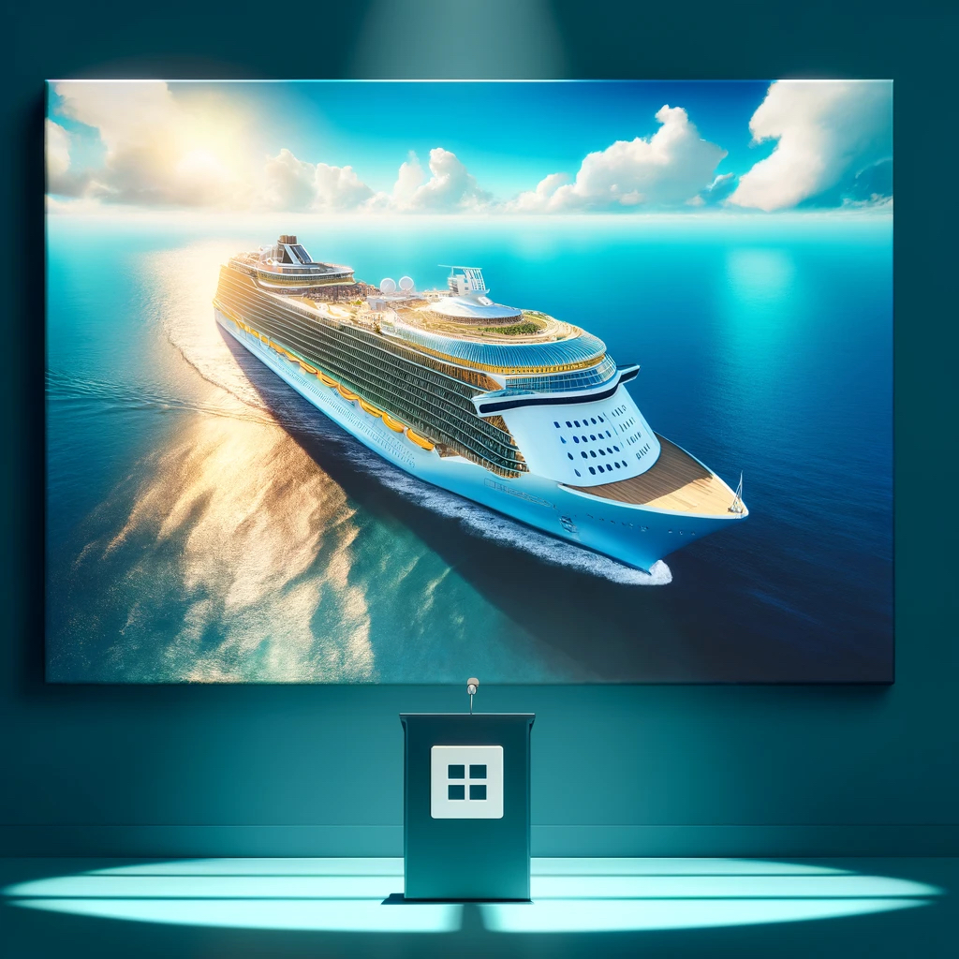
Overview
Royal Caribbean Group, a leader in the global cruise industry, operates Royal Caribbean International, Celebrity Cruises, and Silversea Cruises. With a fleet of 65 ships, the company travels to over 1,000 destinations worldwide.
The company is committed to sustainability and ethical practices, focusing on reducing environmental impact and enhancing community engagements.
To bring RCG’s sales and stock back to pre-pandemic level. Slumped 80% (stock)
to do that they had to lift the no-sail band from the CDC ( Centres of Disease Control and prevention)

Slide 3
Issues Raised in The Case Study
Crisis Management in the Tourism Industry
Health and Safety Concerns
Stakeholder Engagement and Trust Building
Media Relations and Reputation Management
Regulatory Compliance
Financial Resilience and Recovery

Slide 4
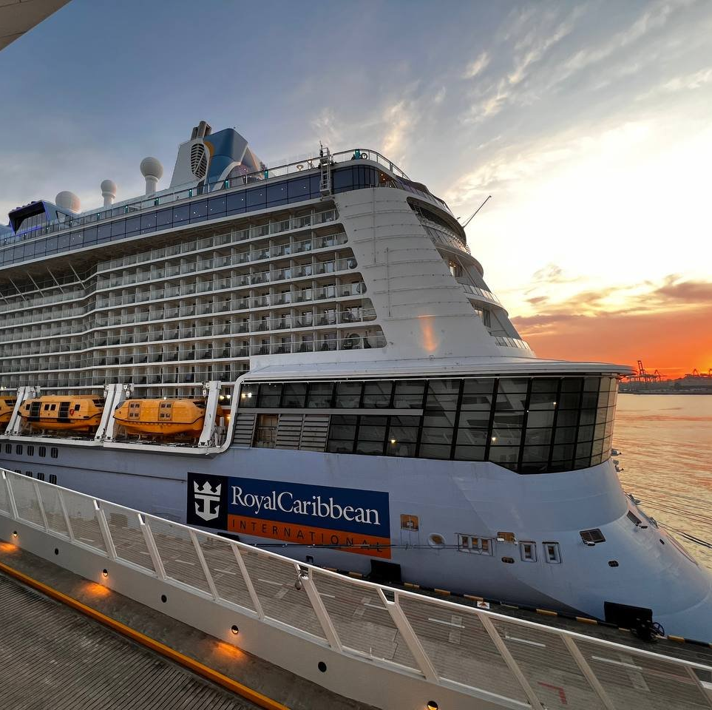
Execution
Public launch of the campaign with comprehensive materials and media training.
CEO Richard Fain's prominent role in communicating safety standards.
Financial support provided to travel partners, generating positive media coverage.
Successfully managed media coverage, emphasizing industry recovery and safety protocols.
RCG's CEO conducted numerous interviews to reach investors and the broader public.
CDC accepted HSP recommendations, allowing ships to sail again

Slide 5
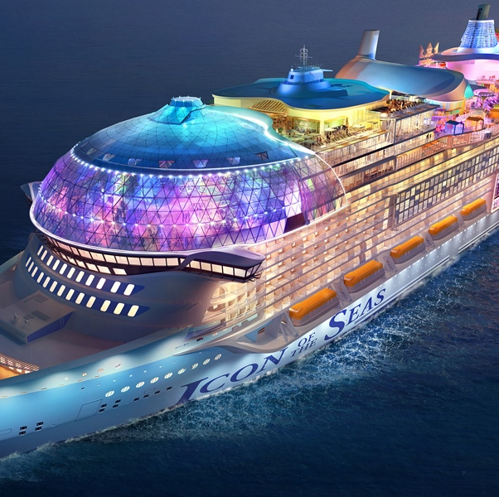
Main PR tactics used:
Strategic Messaging Development
Executive Leadership Communication
Stakeholder Engagement
Financial Support Initiatives
Media Relations

Slide 6
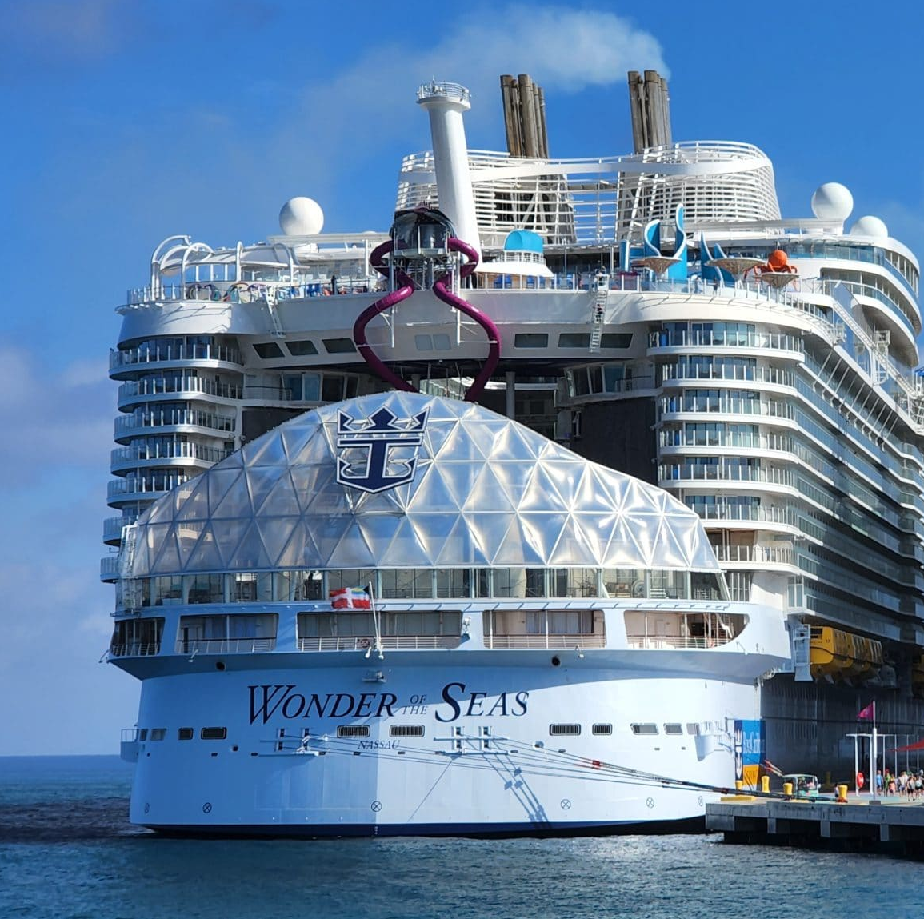
Campaign Evaluation
Regulatory acceptance of RCG recommendations led to CDC lifting No Sail Order.
High guest satisfaction scores recorded on initial sailings.
Positive media coverage increased, surpassing industry average.
Investor confidence boosted, reflected in stock price increase.
Financial support initiatives for travel partners positively received.
Consumer interest in cruising nearly returned to pre-pandemic levels.

Slide 7
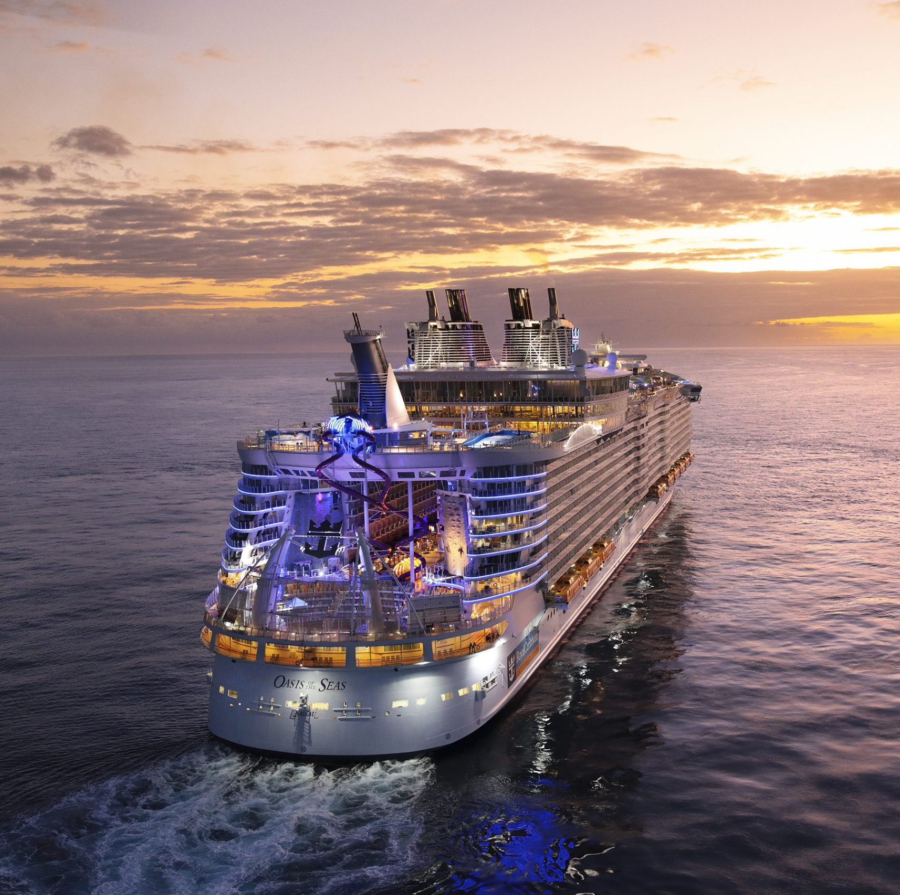
Opinions about the Case Study
A Case Study Written in Hindsight
Risk Tactical Plan and a Global Pandemic
Strategies vs Tactics during COVID-19

Slide 8
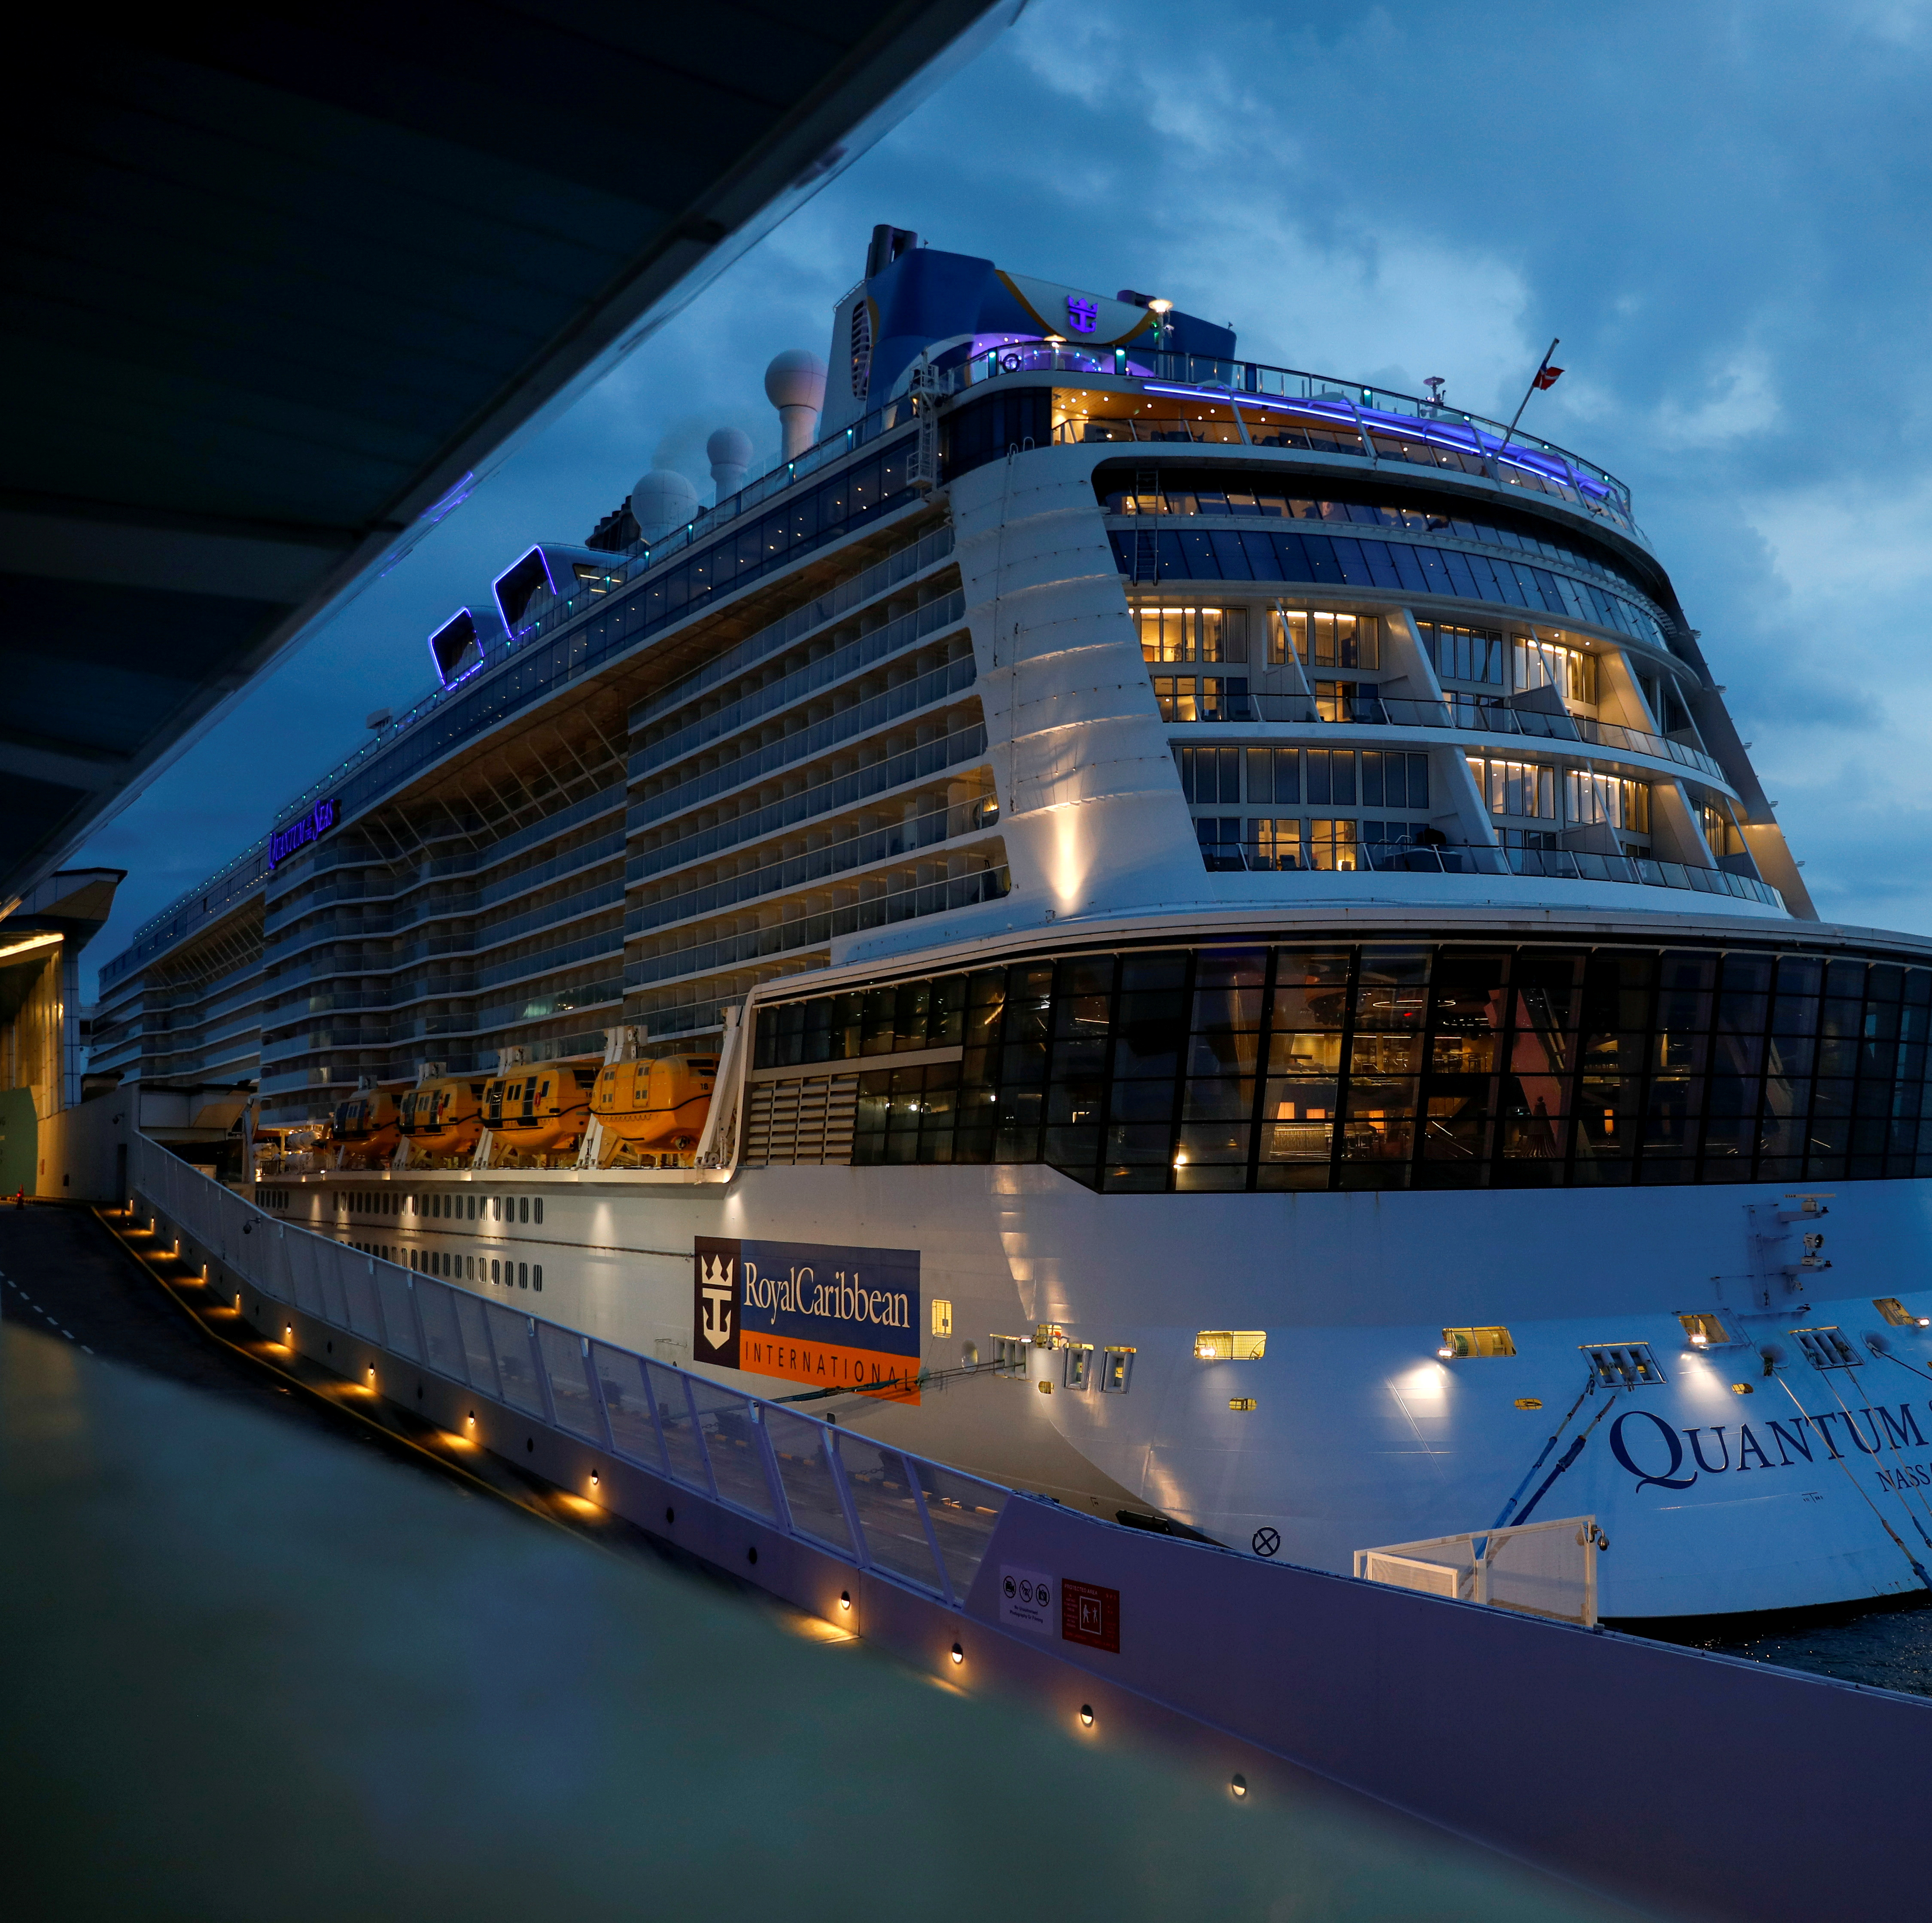
Assumption: Comprehensive Health and Safety Protocols Will Fully Restore Stakeholder Confidence
Old & New Customers
Impact of Safety Protocol on Consumer Confidence
Faith Through Communication (communication gaps)
Failed Projections - The pandemic prevailing
Long term effect
Brand Positioning

Slide 9
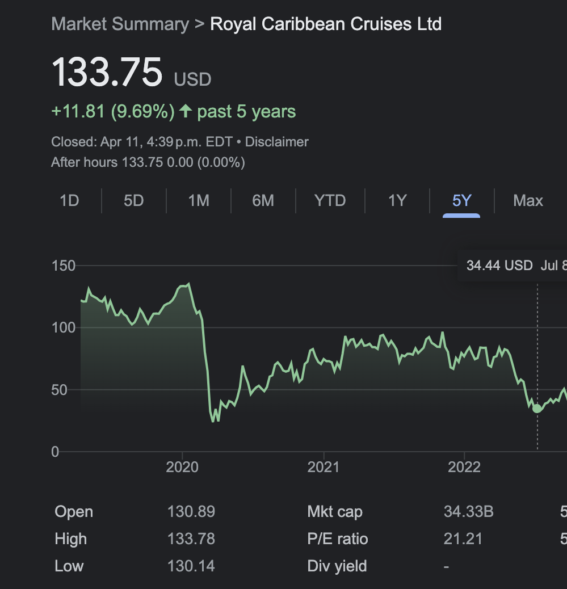
Aspects with No Explicit Evidence or Detail
Details on Research Methodology
Quantitative Impact of Communications Efforts (Immeasurable Impact)
Specific Financial Impact on Travel Partners from the Loan Program
Comparison of Pre- and Post-Pandemic Performance Metrics
Regulatory Bodies and Health Authorities Outside the U.S
Local Communities at Port Cities

Slide 10
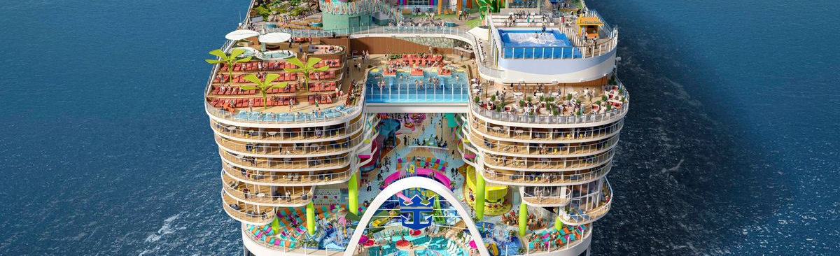
Recommendations
Refundable Deposit, No-Penalty Cancellations or credit options/vouchers
Enhanced Customer and Community engagement (Employee wellbeing)
Investment in Technology
Sustainability Integration
Transparency and accountability

Slide 11
